Slide 1

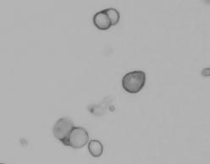

Single Cell Sample Preparation
Diana Burkart-Waco, PhD
Employed by
(but views in presentation are not 100% supported by 10x)

Slide 2
Overview
Why single cell?
Methods – SC isolation
Single cell isolation
Single nuclei
Methods - sample QC
Do I have single cells?
Are they alive?
Are they too big?
Did I isolate the correct cells?
Cell labeling
Single cell studies at DNA Tech

Slide 3
scRNA-seq

Slide 4
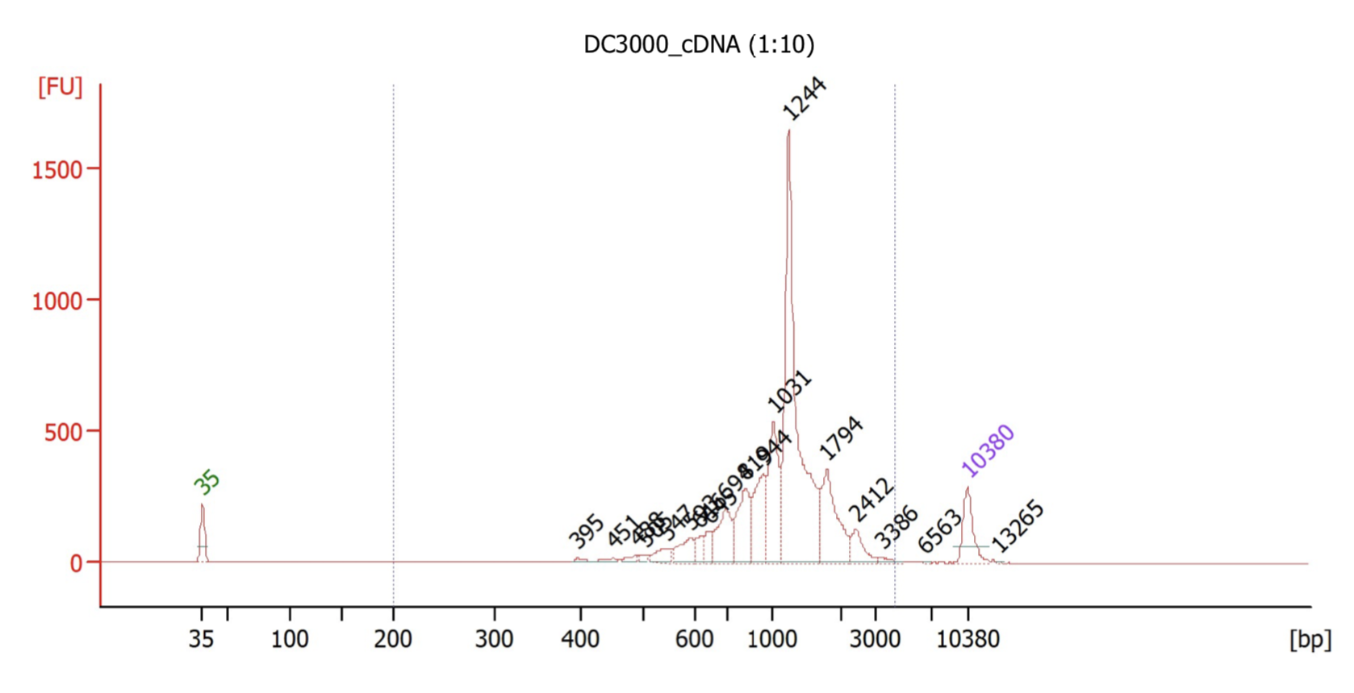
10X Genomics
Captures 100-10,000+ cells per sample.
Recovers up to ~65% of cells.
Low doublet rate.
(~0.8% per 1,000 cells).
30-40 micron size limit.

Slide 5
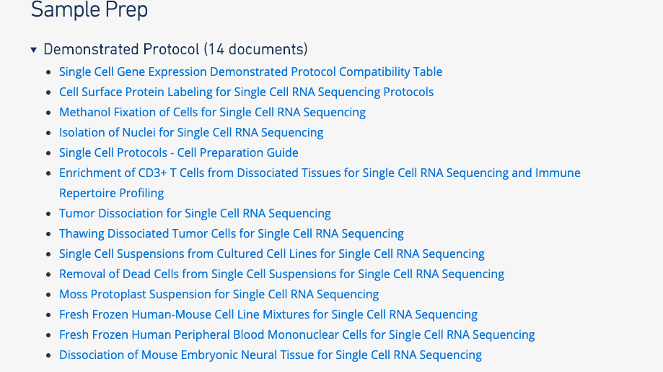
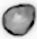
Sample Prep Guides
Cell isolation guides available at:
https://www.support.10xgenomics.com/single-cell-gene-expression/sample-prep/
Cell isolation → biggest source technical variation.
Dissociation and preparation depends on cell type.

Slide 6
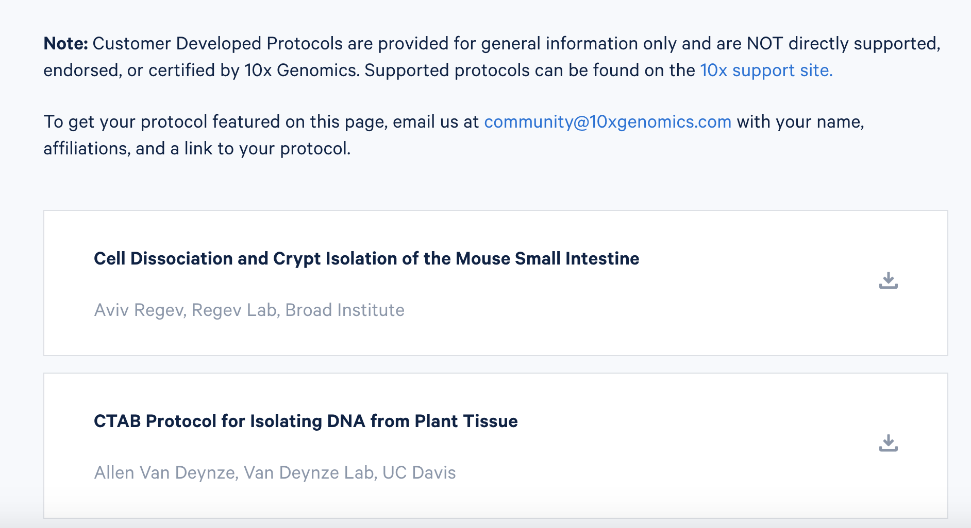
Customer Protocols
User-developed protocols:
https://www.10xgenomics.com/resources/customer-developed-protocols

Slide 7
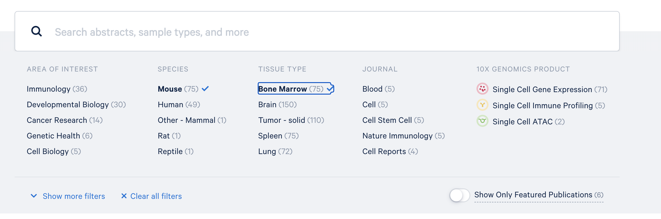
Additional Resources
Publication library
https://www.10xgenomics.com/resources/publications

Slide 8



General Workflow
Tissue dissection
Fast, reliable, clean.
Mechanical mincing
Trituration, razor blade, etc.
Enzymatic breakdown
E.g. Trypsin, dispase, collagenase)
Often with agitation
Obtain cell interest (flow)
Remove dead cells (beads, etc.)
Cell enrichment
(optional)

Slide 9
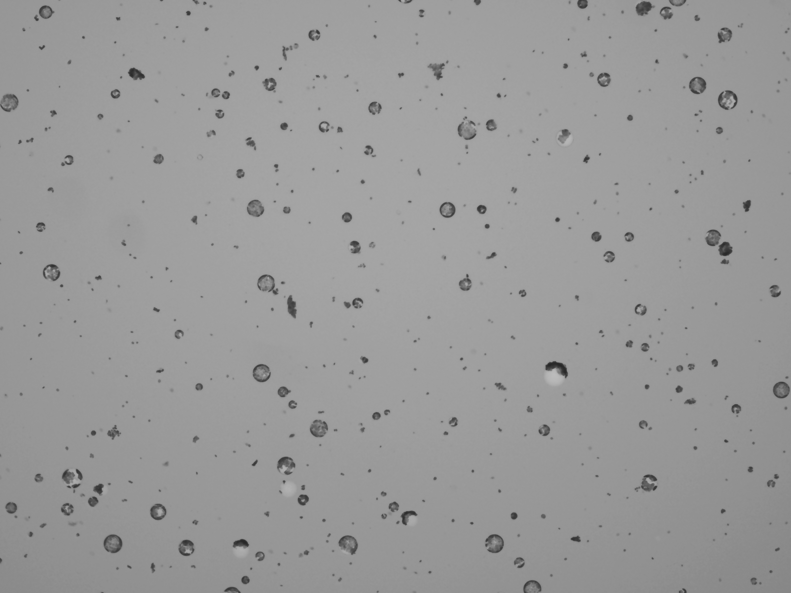
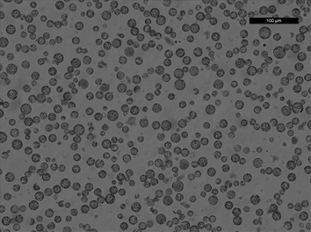
Tissue Dissociation
Many ways to dissociate tissue:
Mechanical
Enzymatic
Automated blending
Microfluidics devices
Considerations:
Speed
Consistency in results
Good representation of all cell types
Arabidopsis protoplasts
Same method, different days.

Slide 10

Factors Influencing Dissociation
Unfortunately, SC sample optimization is best achieved through trial and error…

Slide 11

Single cell vs. nuclei
Single cell captures more transcripts, but is a harder protocol.
When to use nuclei:
Cells cannot be harvested intact or viable (e.g. adipocytes, neurons).
Cells are too big for capture (e.g. cardiomyocytes).
Tissue frozen.
Tissue dissection
Detergent
Grinding
Cell lysis
Flow cytometry
Density Gradient
Nuclei purification

Slide 12
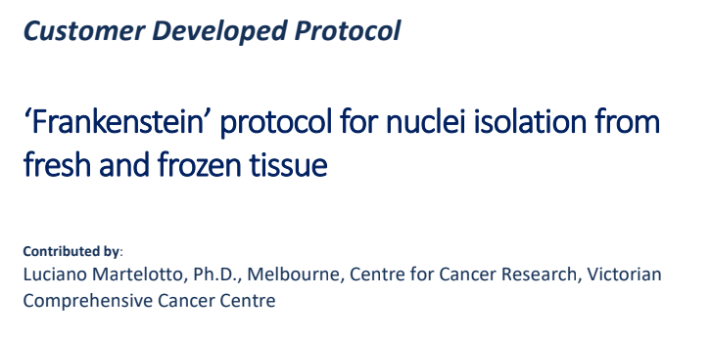
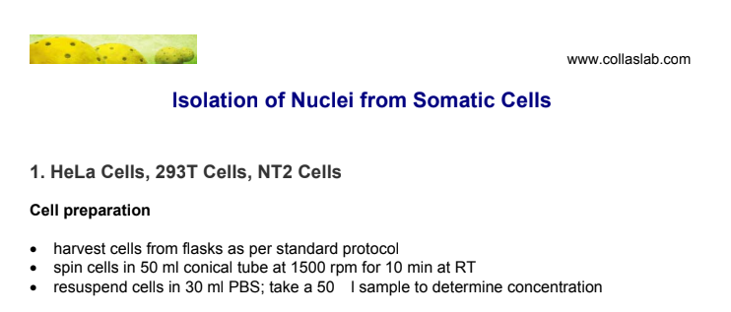
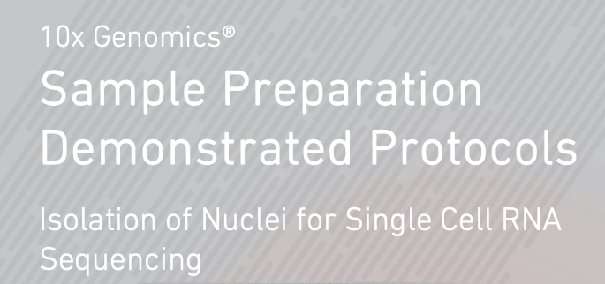
Nuclei protocols
Start here:

Slide 13
Factors influencing success
Cell debris / dead cells
Clog microfluidics, free floating RNA → noise.
Aggregates
No longer single cell data.
Clog microfluidics.
Buffer
Inhibit polymerase → decrease library complexity.
Storage conditions
But the most important factor is cell / nuclei counting!

Slide 14
Workflow
Single cell suspension
Visually inspect cells
Microscope or automated cell counter
Filter, etc.
NO
Free of debris / live
YES
Count

Slide 15
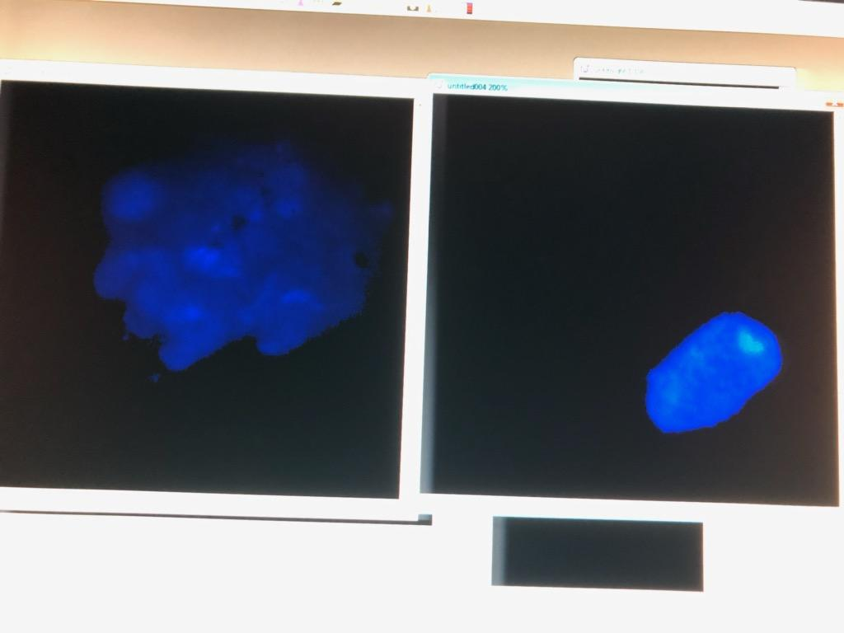
Tissue aggregates
DAPI stain
60X
No scale bar
Single nucleus
Tissue clump
Recommended treatment: optimize tissue dissociation

Slide 16
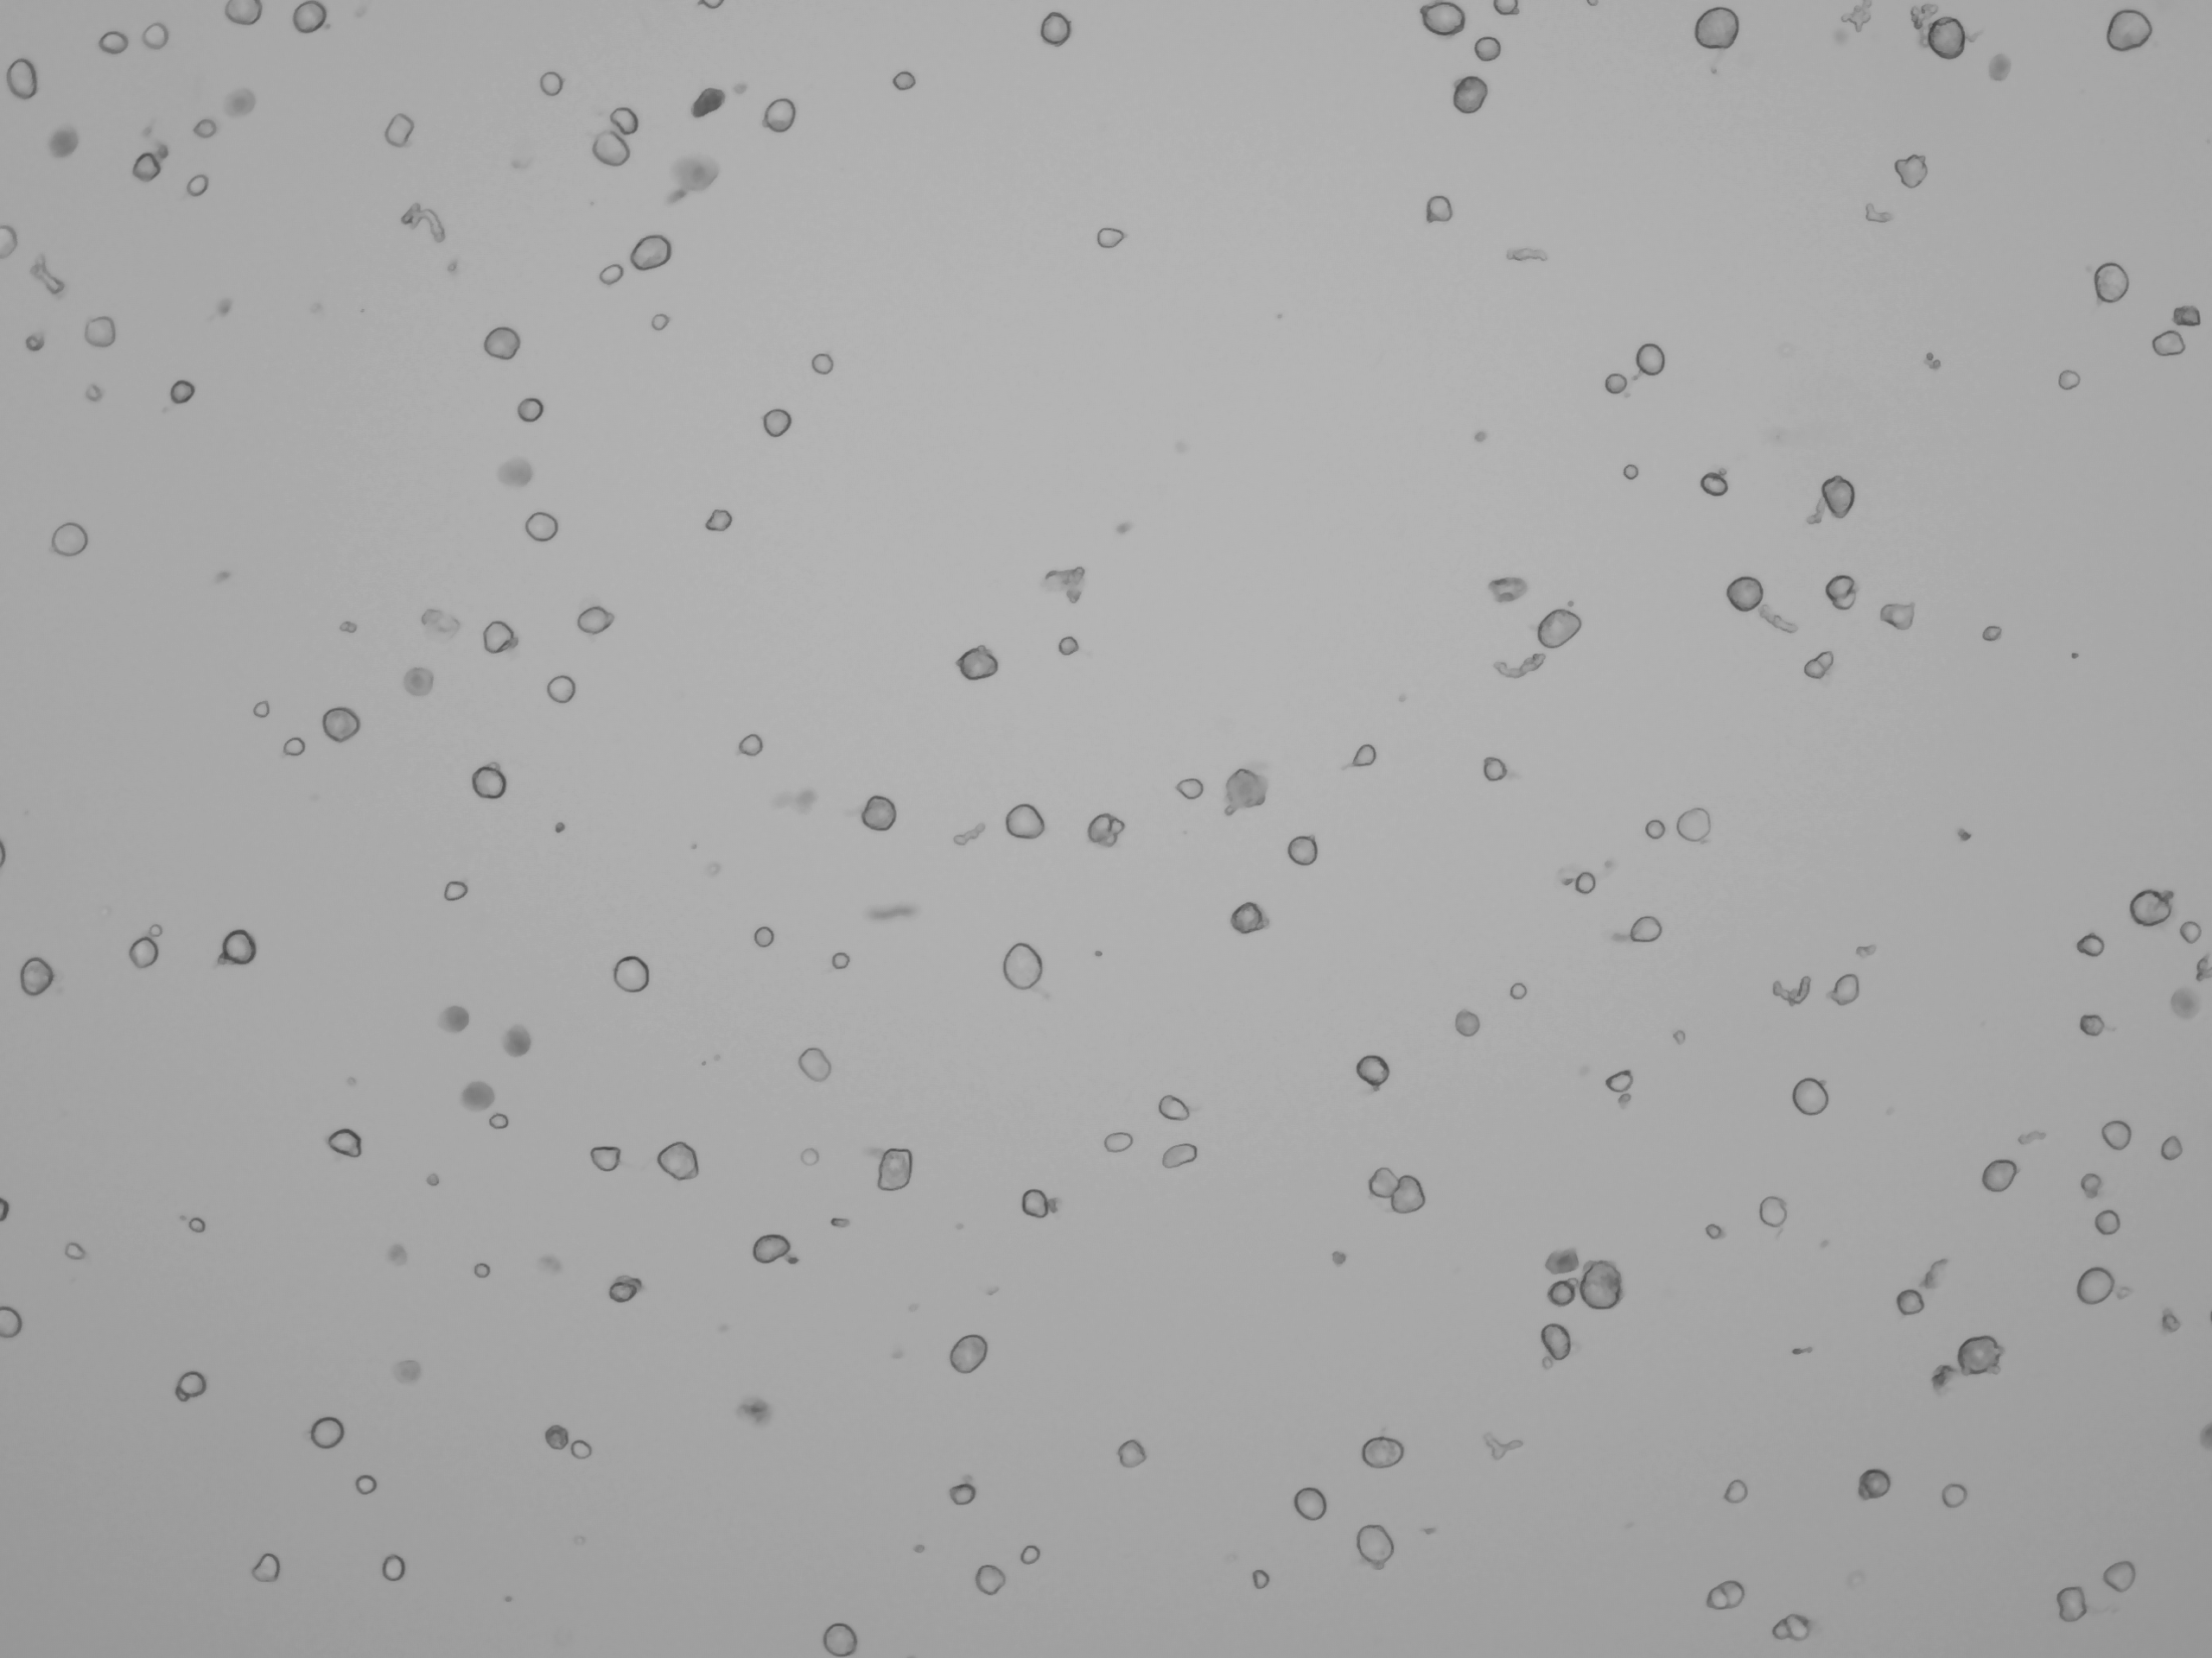
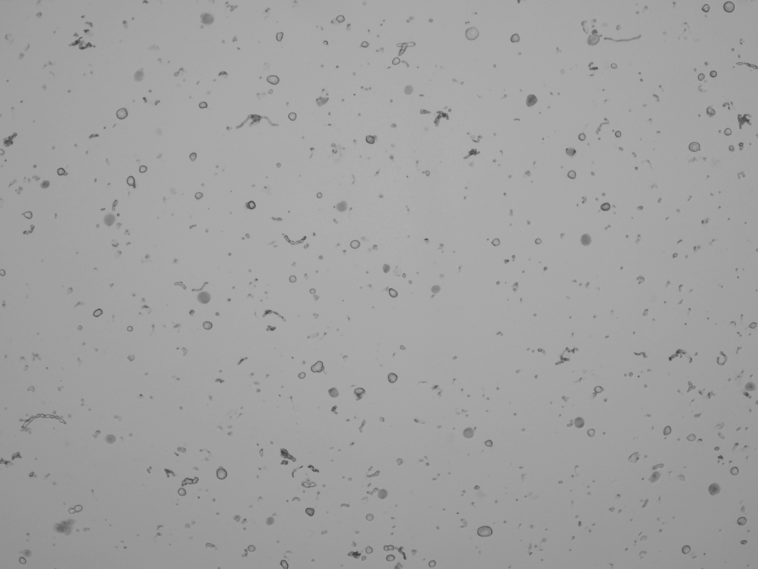
Cell debris
Mouse DRG.
Clean DRG sample Noisy sample
Recommended treatment: filtration (If debris big), centrifuge, add blocking agent.

Slide 17
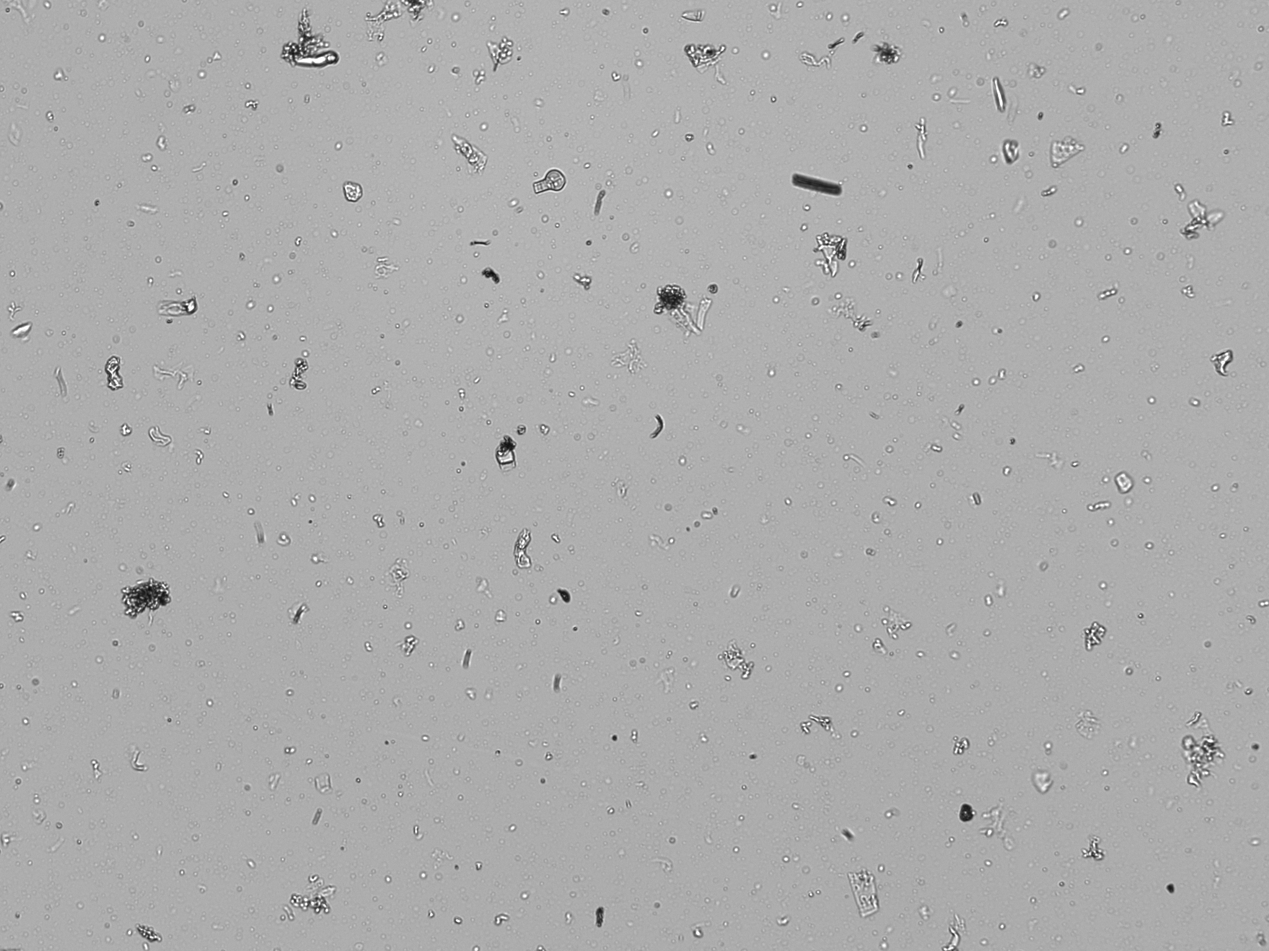
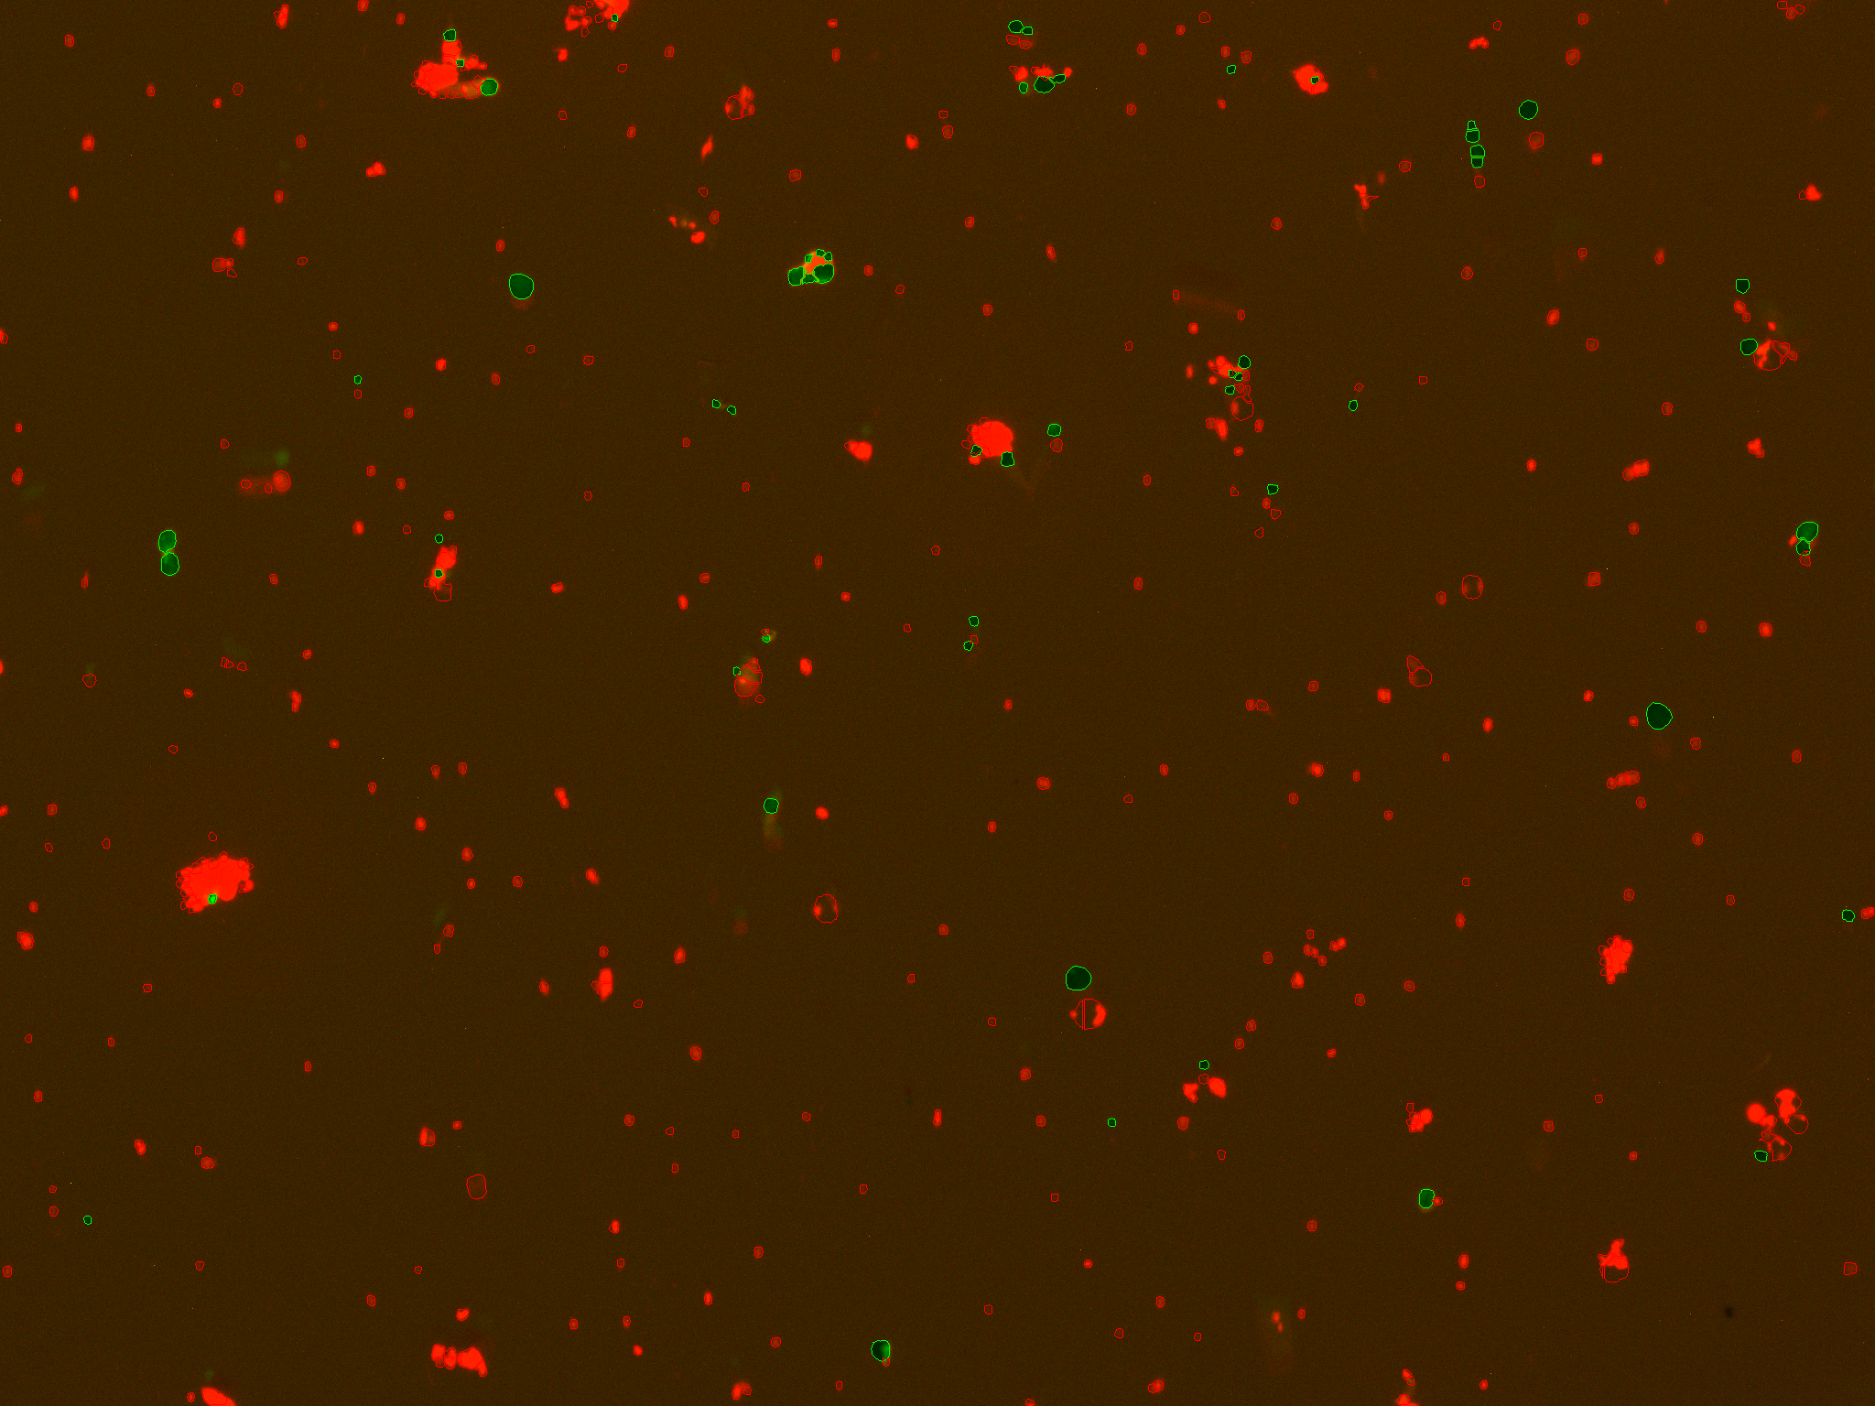
Cell debris II
Lettuce nuclei prep.
Photo credit: Mohan Prem Anand Marimuthu
Recommended treatment: modify dissociation times / detergent concentrations, change density gradient.

Slide 18
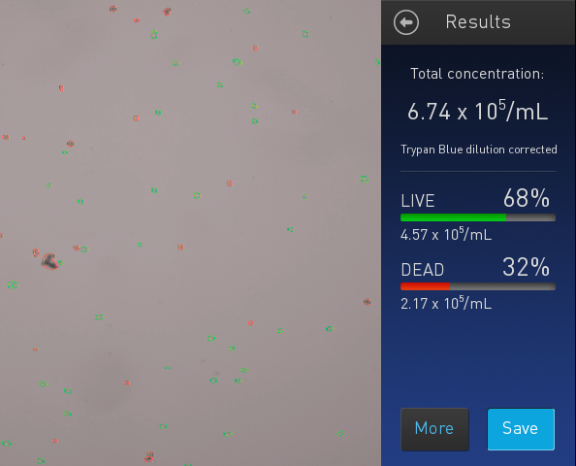

Dead cells (+debris?)
Recommended treatment: dead cell removal.
https://www.miltenyibiotec.com/US-en/products/dead-cell-removal-kit.html

Slide 19
Doublets
Non-single cell clumps.
Integrated into droplets and cannot* distinguish from single cells.
Doublet
Bad for any single cell experiment.
Recommended treatment: filtration, change [blocking agent]

Slide 20
Workflow
Single cell suspension
Visually inspect cells
Starting over >> manipulation
Filter
NO
Free of debris / live
YES
Count

Slide 21
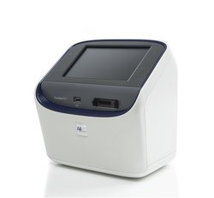
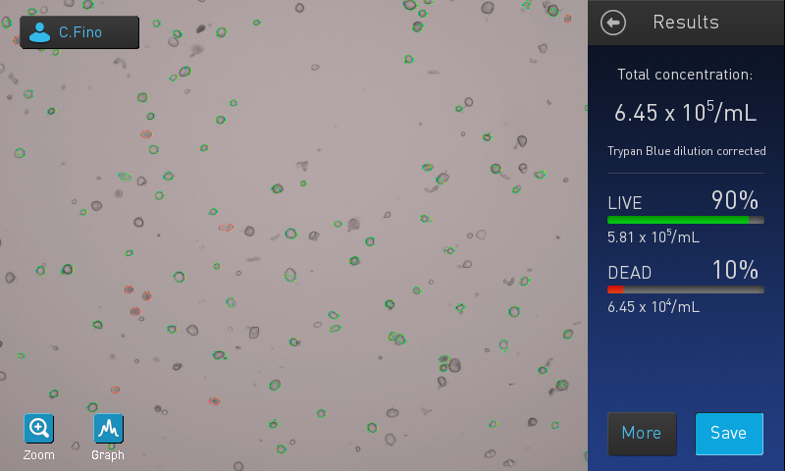
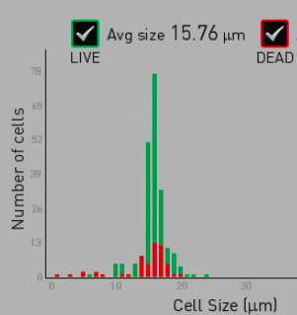
Automated counting
Countess II.
Pros (+):
Fast.
Live/dead cell counts.
Cell size estimates.
Cons (-):
Cell size limits (4-30um).
Doesn’t do well with odd cell shapes, debris, nuclei.

Slide 22
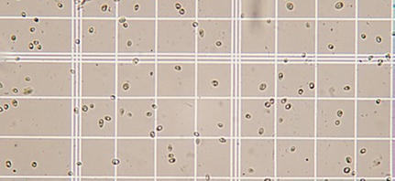
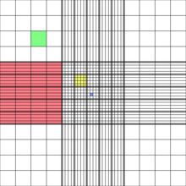
Manual counting
Hemocytometer.
http://www.wetnewf.org/pdfs/hemocytometer.html
Pros (+):
Reliable cell counts.
Count small cells.
Visualize cells vs. debris.
Cons (-):
Slow.

Slide 23
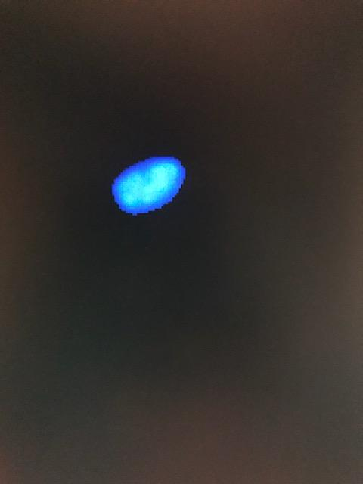

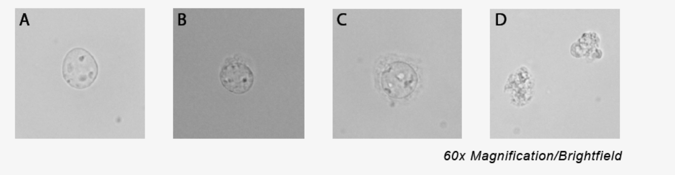
Nuclei QC
Use fluorescence.
Countess II FL, Devonix CellDrop, Luna FL.
Stains
Trypan blue → 100% dead (not great).
Ethidium homodimer stain (good for excluding debris).
DAPI, AO/PI other options
60X: DAPI
Credit: 10X
Hemocytometer
CountessII

Slide 24
Cell sorting
FACS
Pros (+):
Sort live / dead.
Enrich cells of interest.
Determine whether correct cells isolated (qPCR works too).
Cons (-):
Not accurate for cell counts.
https://flowcytometry-embl.de/cell-sorting/

Slide 25

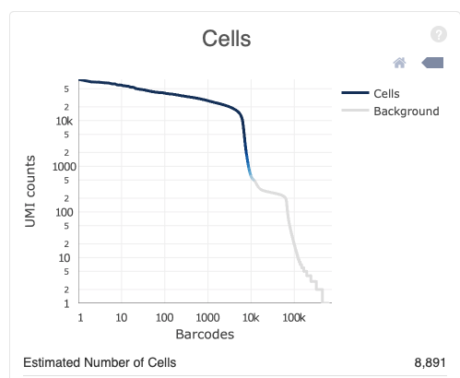
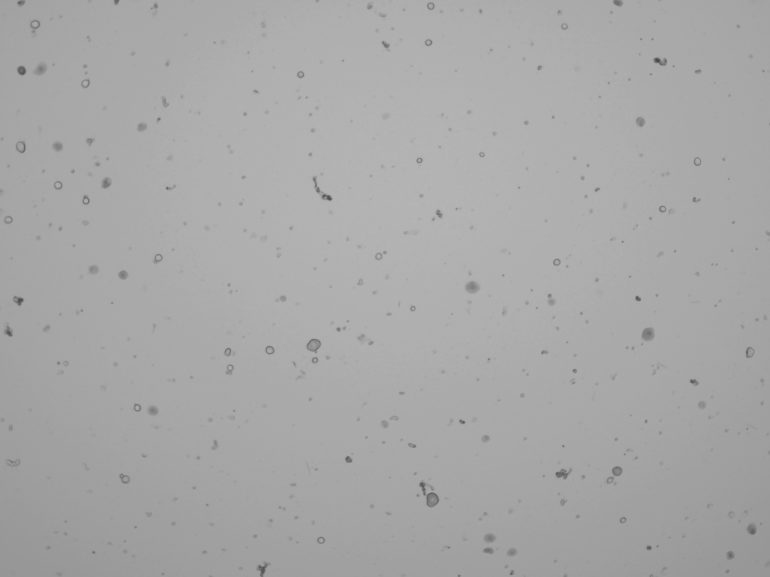
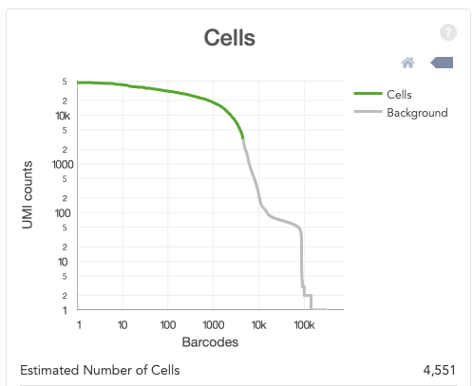
The good…

Slide 26
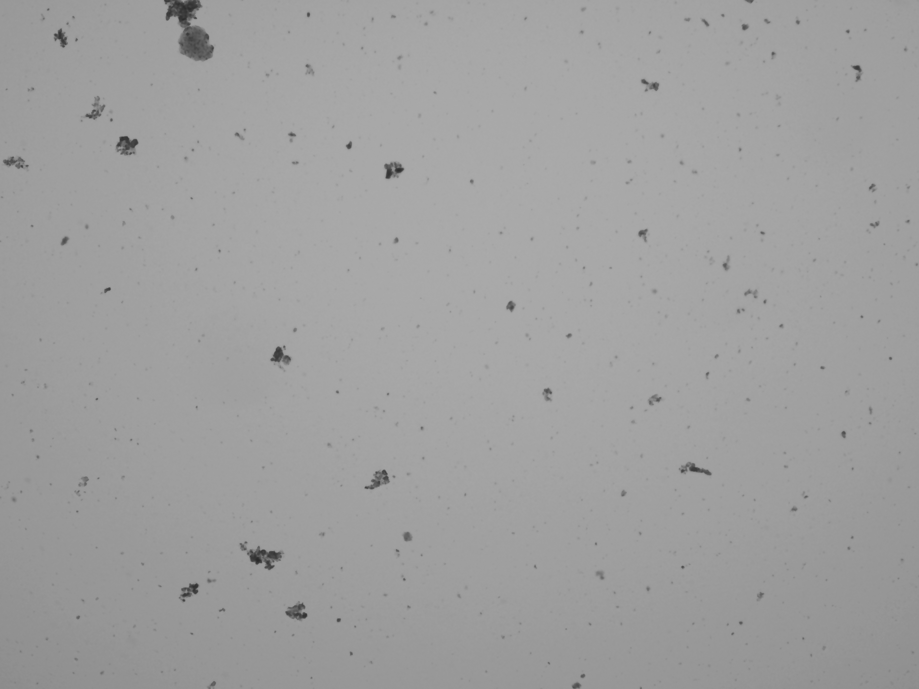
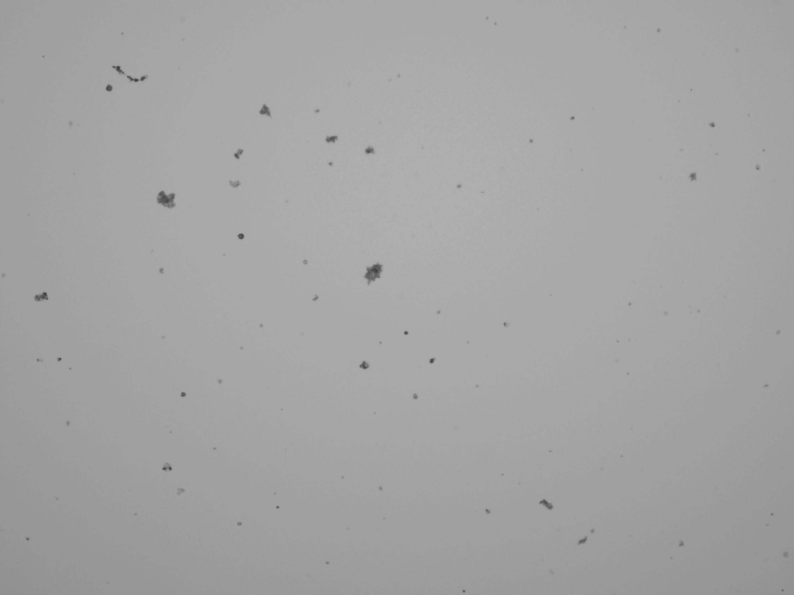

The bad…

Slide 27
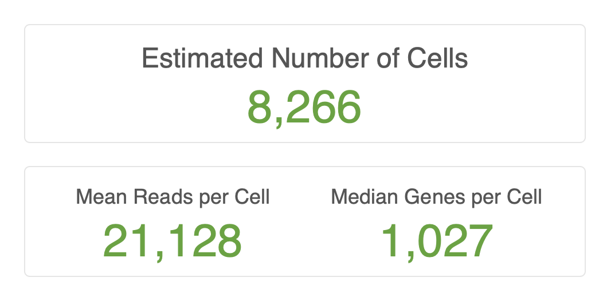

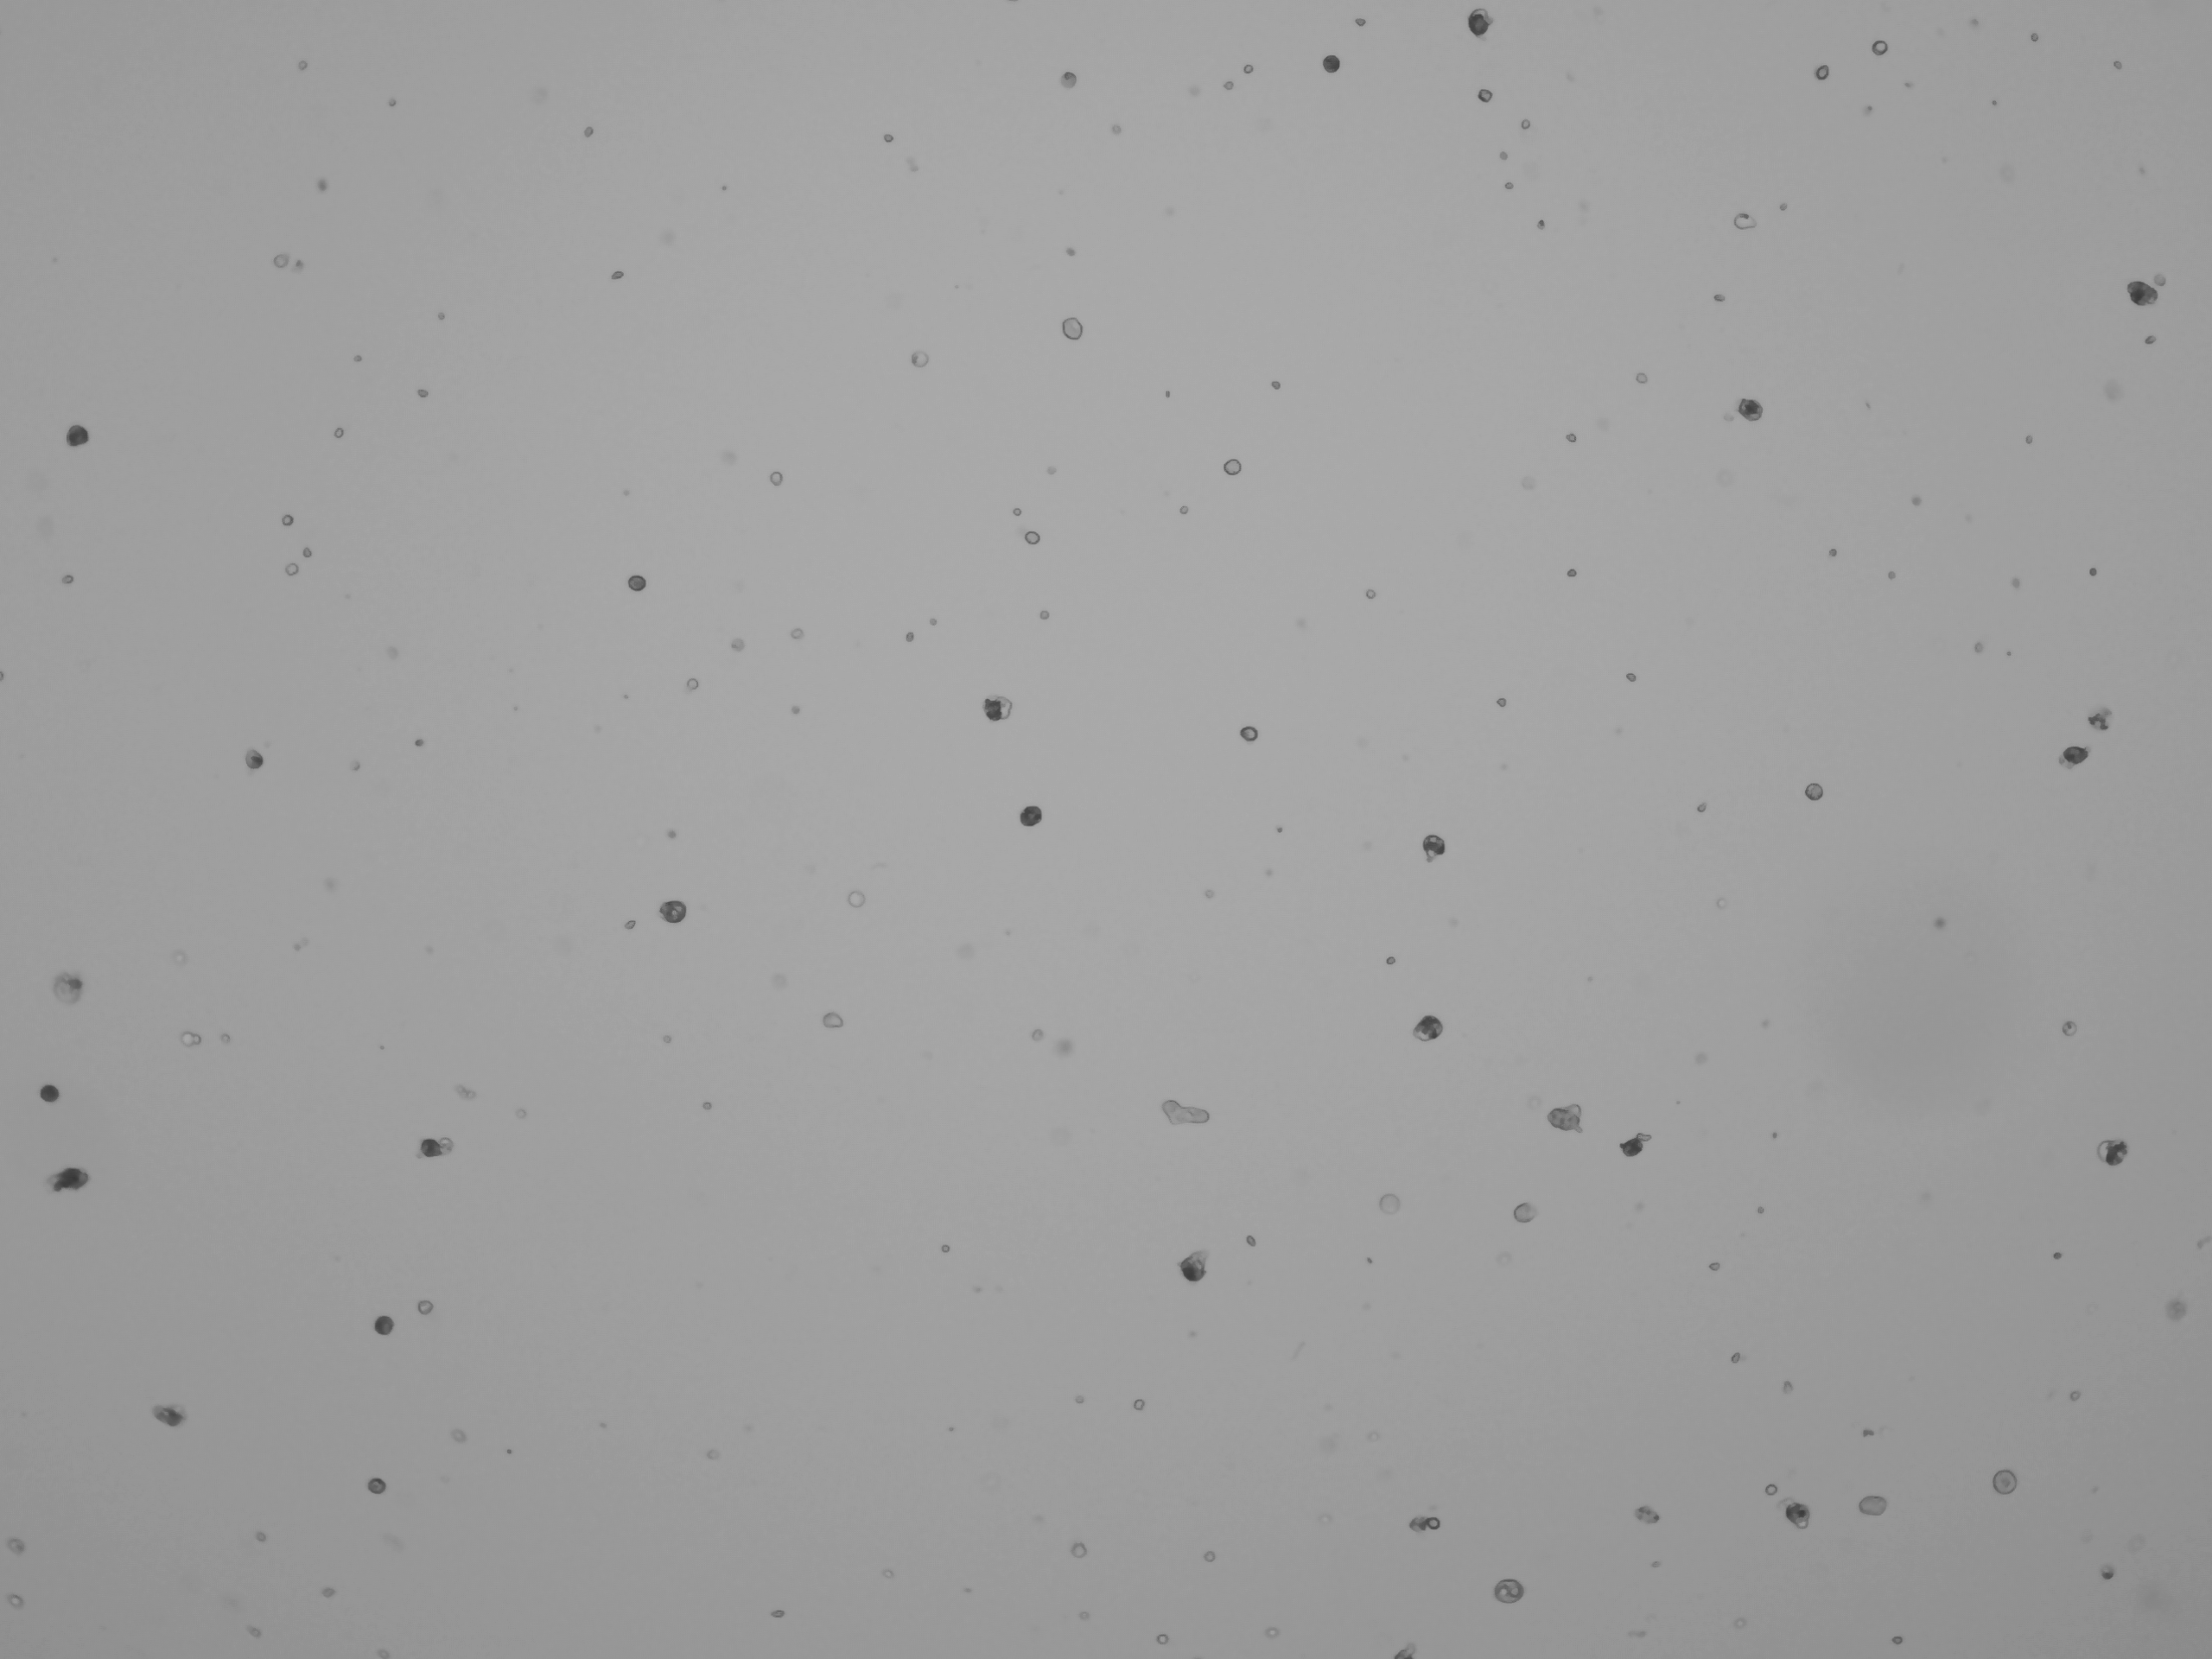

Challenges Cell Recovery
Some samples easy - human PBMCs, etc.
Round, easy to count, size well below size of microfluidics.
These yield consistent results. 10K target. 8K-10K recovered.
But most experiments outside of culture don’t look like this.
Nuclei (100% dead)
Variable size, shape, and viability
Hydra
Human bone

Slide 28
How maximize output?
Carefully craft experimental design and sample prep .
QC cells before real sample set-up.
Concentration: aim for the median.
700-1,200 cells per µl optimal.
Too high → dilute.
Too low → tough one (concentration impacts yield, pooling replicates suboptimal).
Count in replicates (at least n=2).
Viability: 70% minimum.
Nuclei and methanol fixed cells (0%).
Treat cells gently.
Wide bore pipette tips, keep cells at preferred temp, work quickly..

Slide 29
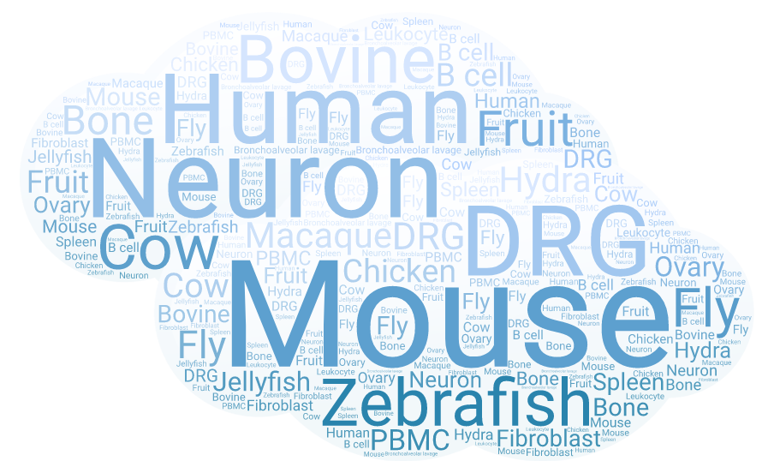
10X Single Cell Studies - DNATECH

Slide 30
Assay summary (organism)
78 projects since July 2017 (primarily 3’ GEX).
Sample distribution by organism
Bovine
Human
Mouse

Slide 31
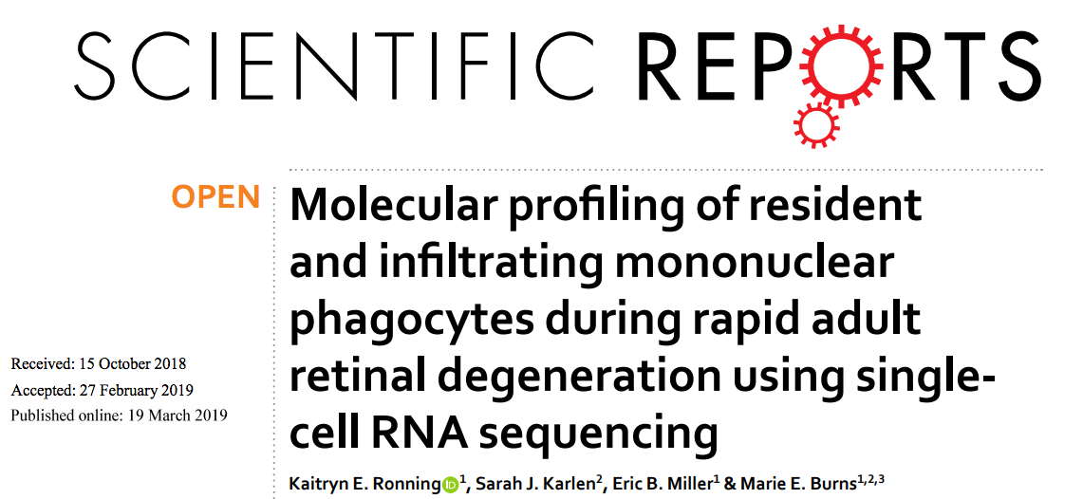
Retinal degeneration

Slide 32
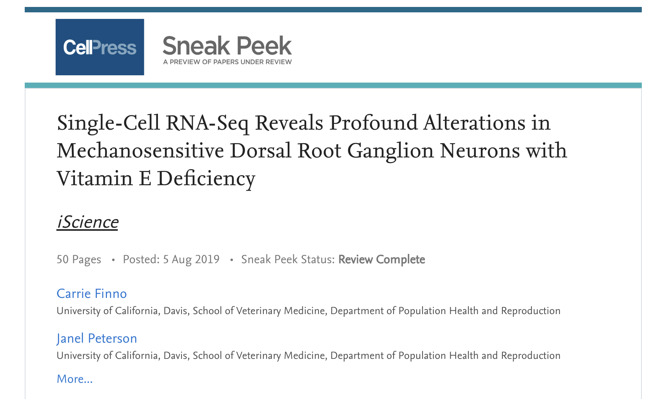
Vitamin E deficiency

Slide 33




Course dataset
PBMCs
Recovered
Covid
Patients
Blood
B cells

Slide 34
Input Material

Slide 35
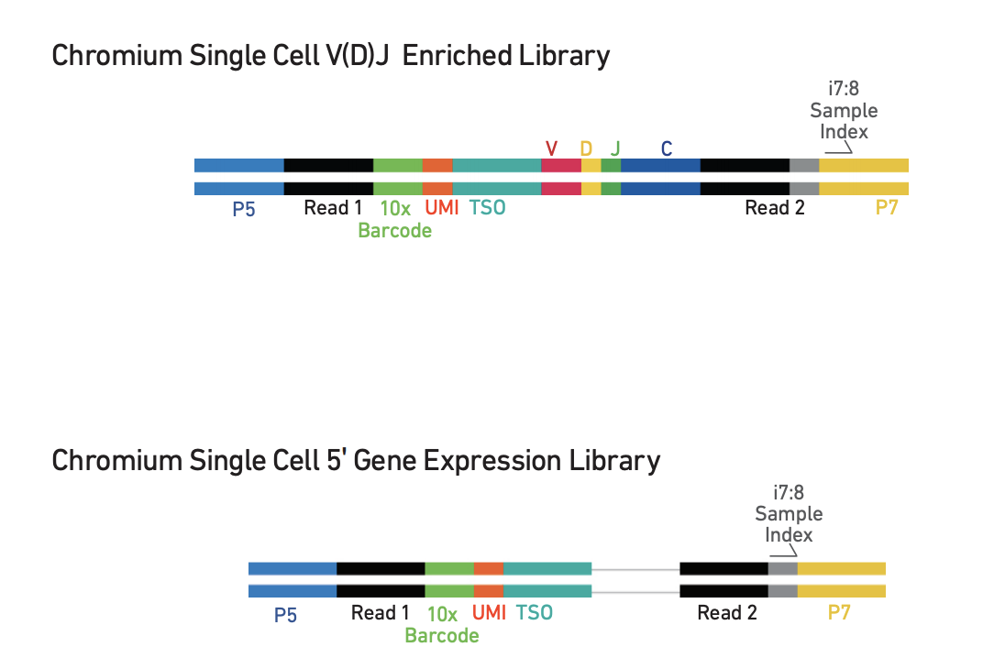
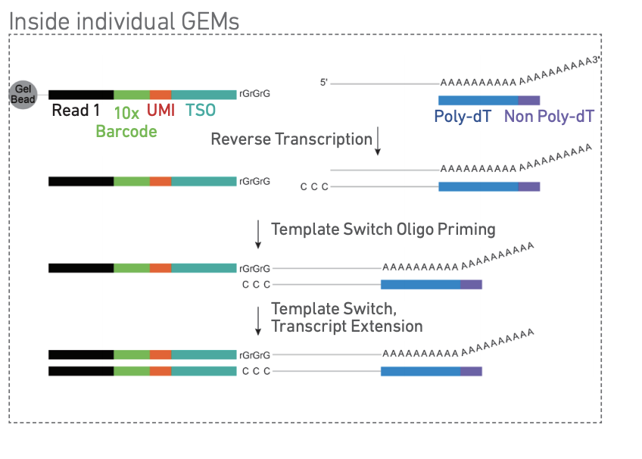
Final Libraries
Bead capture with TSO sequence → 5’ bias transcripts.
2 libraries from each cell type (GEX and V(D)J).

Slide 36
Important resources
10X Genomics
https://support.10xgenomics.com/single-cell-gene-expression
support@10xgenomics.com
Paul Scott, Sales Executive (paul.scott@10xgenomics.com)
UC Davis Flow Cytometry
http://www.ucdmc.ucdavis.edu/pathology/research/research_labs/flow_cytometry/index.html
Bridget McLaughlin (Technical Director)
UC Davis DNA Technology Core
http://dnatech.genomecenter.ucdavis.edu/single-cell-analyses/
UC Davis Bioinformatics Core
https://bioinformatics.ucdavis.edu/

Slide 37
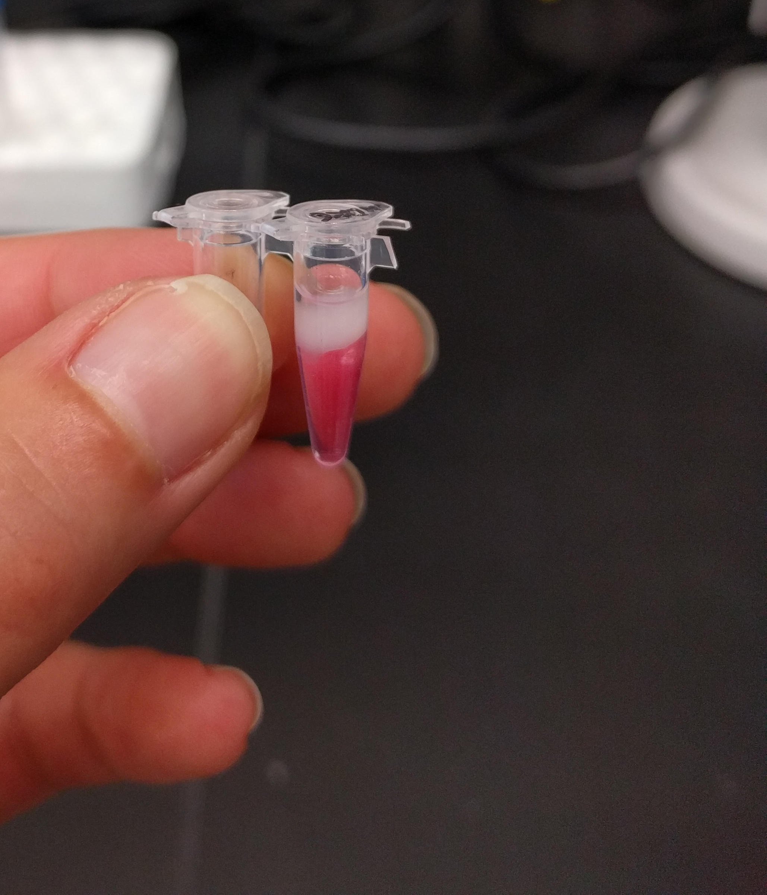
Acknowledgements
UC Davis DNA Technology Core team.
UC Davis Bioinformatics Core team.
10X Genomics.
Adam Bemis (Field Applications Scientist)
Paul Scott (Sales Executive)
Nicole Abreu (Technology Advisor)

